Slide 1
Lab 4: You Seem So Distant Using Regression for Prediction
Pre - lab

Slide 2
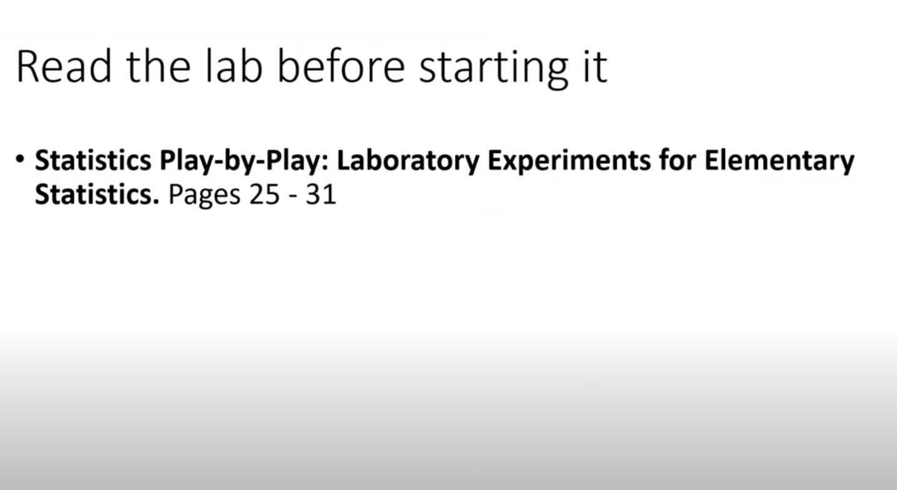

Slide 3
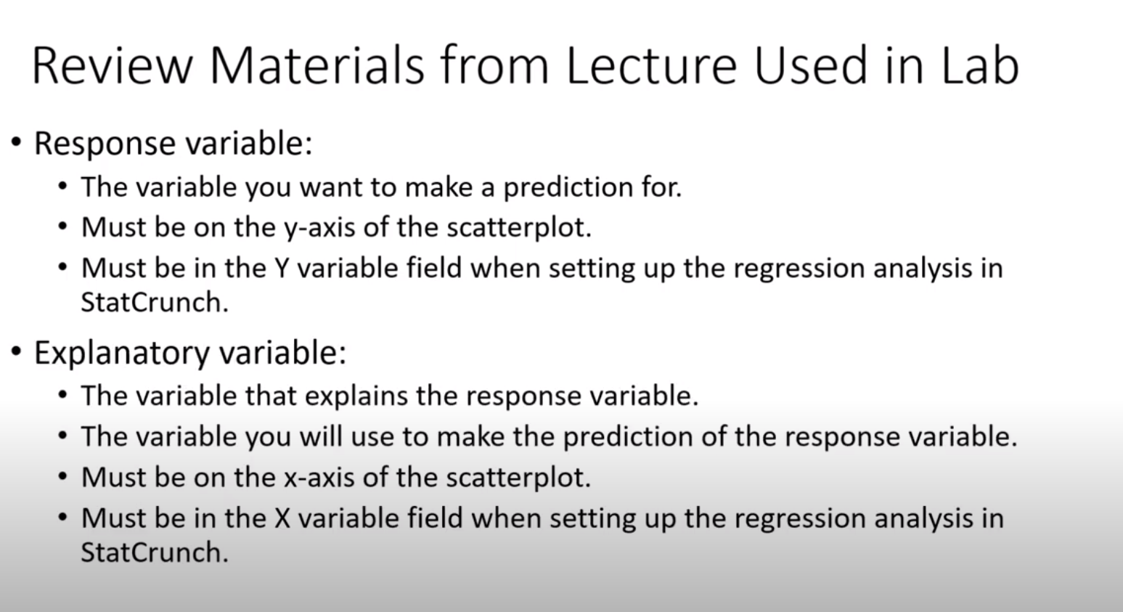

Slide 4

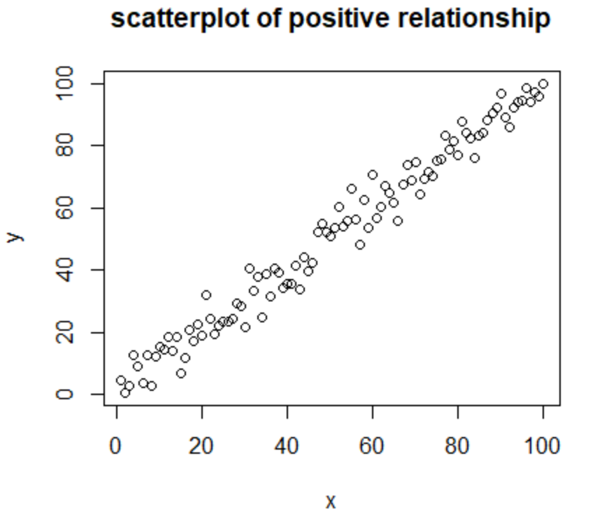
If the pattern is linear:
response variable = slope *(explanatory variable) + y-intercept y = ax + b.

Slide 5
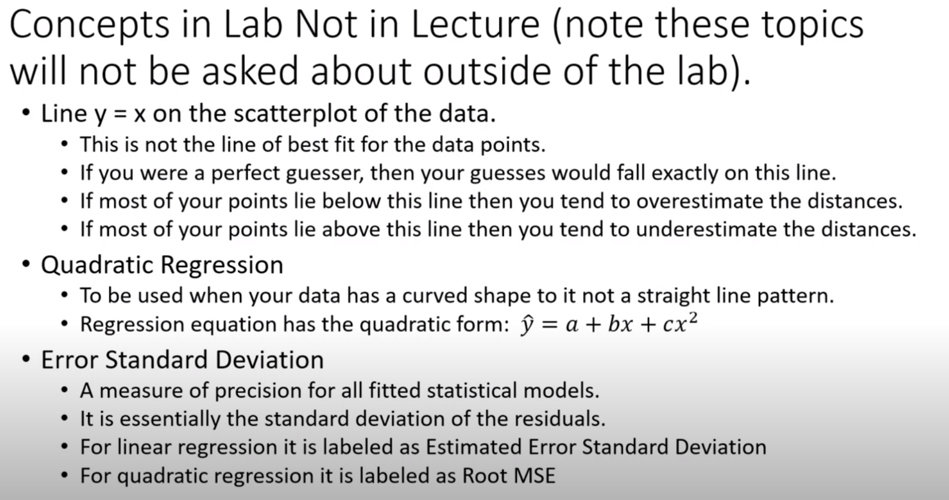

Slide 6
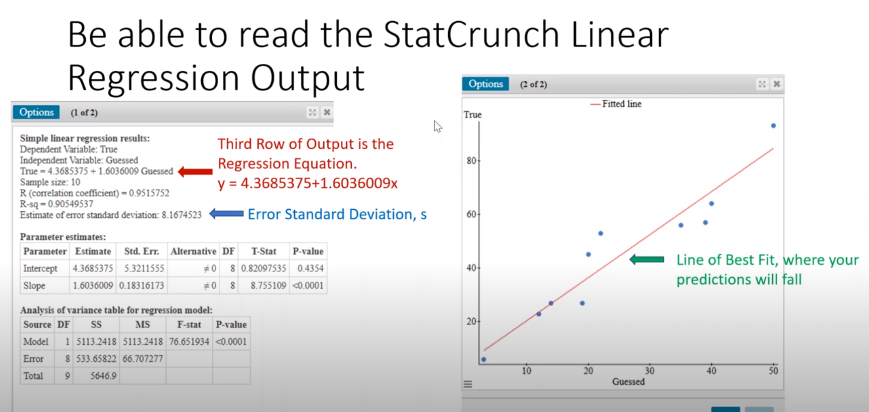

Slide 7
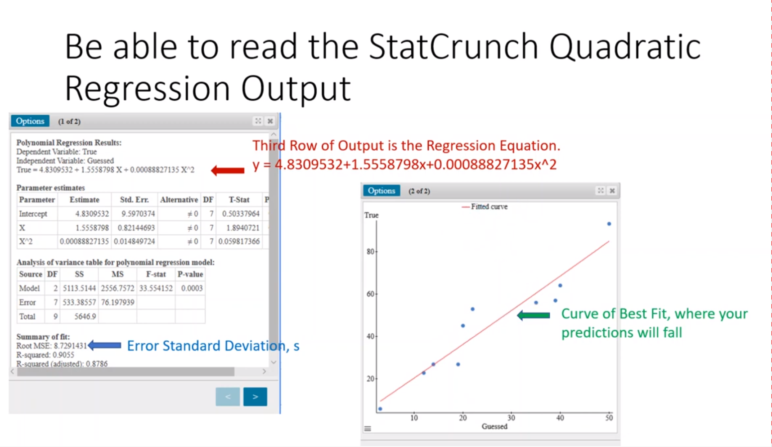

Slide 8
